Slide 1

.NET Development
Lecture 1

Slide 2
Topics
Organizing questions
Platform .NET – total information
Basic information about C#
Simple C# application and its analysis
CLR and C# types system
Primitive value types casting

Slide 3
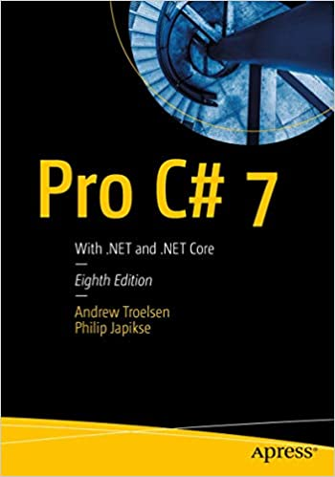

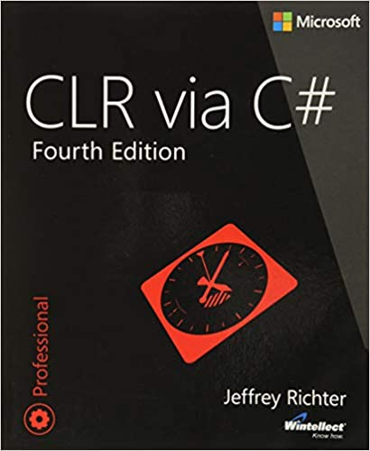
Recommended books

Slide 4
Internet-recourses
https://dotnet.microsoft.com/ – «input point»
https://docs.microsoft.com/en-us/dotnet/ – official documentation for .NET 5
https://github.com/dotnet – source code of .NET 5
https://metanit.com/sharp/ – training
https://dotnetfoundation.org/projects – open-source Microsoft projects

Slide 5
Development tools
Important: work with .NET 5 and C# 9.
Case 1: Full IDE: Visual Studio 2019 (16.8.0 and higher) or Visual Studio for Mac (8.8 and higher). Useful link: https://visualstudio.microsoft.com/.
Case 2: Text editor (for example, Visual Studio Code) and средства .NET Core CLI (in .NET SDK).

Slide 6
.NET Framework
This is a platform for applications released by Microsoft in the beginning of 2000-th. Has open specifications (but closed source code).
.NET Framework includes 3 main components:
Runtime engine (Common Language Runtime, CLR)
Base class library (Base Class Library, BCL)
set of technologies for applications and services construction

Slide 7
.NET Core and .NET 5
.NET Core – alternative to .NET Framework. Has open source and works on several operational systems. Includes its own implementation of Common Language Runtime (CoreCLR) and basic class library CoreFX.
.NET 5 – further development of .NET Core 3.0. Released in 2020 and presented as unique platform for .NET development, substitution of Mono and .NET Framework.

Slide 8
.NET Framework, .NET Core и .NET 5
2002
2005
2007
2010
2012
2015
2016
2017
2019
2020
.NET
Framework
1.0
.NET
Framework
3.5
.NET
Framework
4.5
.NET
Framework
4.7
.NET
Framework
2.0
.NET
Framework
4.0
.NET
Framework
4.6
.NET
Framework
4.8
.NET
Core
2.0
.NET 5
.NET
Core
1.0
.NET
Core
3.0

Slide 9
Common Language Runtime (CLR)
CLR – core and “engine” of .NET platform.
Main task- control assemblies execution.
Assembly – compiled application or library for .NET.
It contains set of instructions on special language Common Intermediate Language (CIL) and metadata, which describes types in an assembly.

Slide 10
Common Language Runtime (CLR)
Simple application (С++)
Application for .NET
Application code (CIL- instructions)
Application code (CPU-instructions)
Common Language Runtime
Operation system
Operation system

Slide 11
Common Language Runtime (CLR)
What CLR do:
load assemblies for memory
compile CIL to CPU instructions (this process called just-in-time compilation, JIT-compilation)
manage memory allocation during application execution
supports automatic «garbage collection» (finds and releases unused memory)

Slide 12
Managed code
CLR manage assemblies and memory, thus for .NET platform applications and code we use term managed code.
Code not for .NET called unmanaged code.

Slide 13
Programming languages for .NET
Due to open specifications each person or company can create language for .NET platform.
As a result, there are dozens of languages.
Most popular:
C#
Visual Basic.NET
F#
C++/CLI

Slide 14
Programming languages for .NET
Each language for .NET is on the «top» of infrastructure. It has specific syntax only for itself but not for names for elements from common class library.
This fact simplify interlanguage interaction and programs transfer from one language to other.

Slide 15
Programming languages for .NET
C#
VISUAL BASIC .NET
public int GetBooksCount()
{
using (var con = new SqlConnection())
{
SqlCommand command = con.CreateCommand();
command.CommandText =
"SELECT COUNT(*) FROM Books";
con.Open();
// ExecuteScalar() returns object
return (int) command.ExecuteScalar();
}
}
Public Function GetBooksCount() As Integer
Using con As New SqlConnection()
Dim command As SqlCommand =
con.CreateCommand()
command.CommandText =
"SELECT COUNT(*) FROM Books"
con.Open()
' ExecuteScalar() returns object
Return CInt(command.ExecuteScalar())
End Using
End Function

Slide 16
Language for .NET and CLR
Typically language elements reflects CLR types. Types of CLR are described in language (maybe with other names).
But language can not use some possibilities of CLR.
At same time, some language «features» can differ only before compilation and merge in result code to similar CLR elements.

Slide 17

Basic facts about C#
Name pronounced as "see sharp"
Developed especially for platform .NET in 2000 (Anders Hejlsberg)
C-like syntax
C# used for more then 70% of all projects for .NET
.NET Framework 4.8 – C# 7.3. New versions (C# 8 и C# 9) only for .NET Core.

Slide 18
Basic facts about C#
OOP-based development only
Static typing - types are known on compile time.
Safe type system – one memory block can’t be «covered» by values of different types
Reflects CLR elements quite fully. In last versions- lot of «syntax sugar».

Slide 19
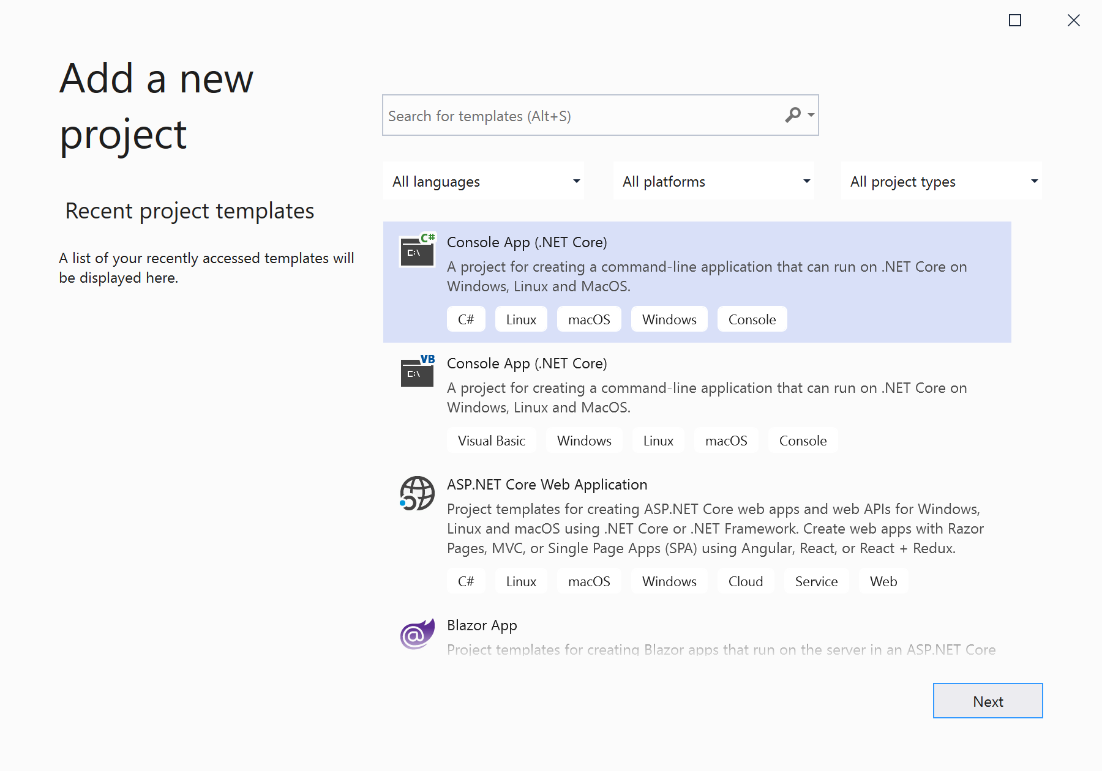
Simple C# application (VS2019)

Slide 20
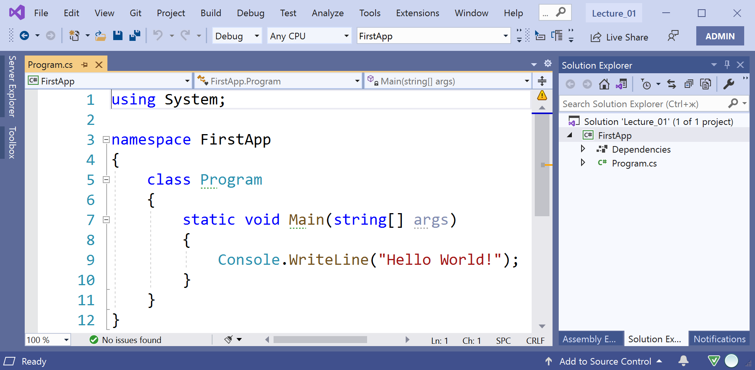
Simple C# application (VS2019)

Slide 21
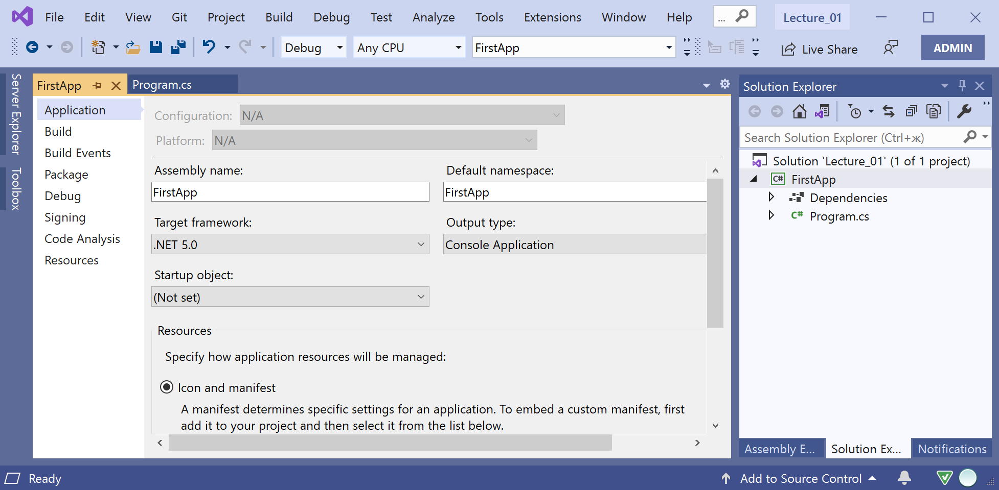
Simple C# application (VS2019)

Slide 22
Simple C# application (VS2019)
using System;
class Program
{
static void Main()
{
Console.Write("Input your name: ");
string name = Console.ReadLine();
Console.WriteLine("Hello " + name);
}
}

Slide 23
Application and its components
Application creation = description of custom types (for example, classes) + types manipulation.
Types can be logically grouped to namespaces, and physically (after compiling) – to assemblies (file with extension.exe or .dll).

Slide 24
CLR and types
Developed system of types – basis of .NET platform and CLR.
How Common Language Runtime operated with types?
Some types are supported on the level of intermediate language CIL (primitive CLR types).
More complicated types are needed in more complicated previous description (using CIL) and only after this can be used (custom (user-defined) CLR types).

Slide 25
CLR and types
Any type is familiar to CLR by unique name, ordinary part of this name is namespace.
For example:
System.Int32 – primitive type for integer numbers in range -2147483648..2147483647.
System.Console – custom data type, class for maniulations with console.

Slide 26
C# types system
From C# viewpoint types are divided into primitive and custom types.
Support of primitive types is provided by compiler, no need to describe such types.
Example, int – primitive type for integer numbers in range
-2147483648..2147483647.
Custom types have to be described before using by syntax constructions.

Slide 27
Primitive number types C#
Category | Type C# | Size (bits) | Range and accuracy
Signed integer types | sbyte | 8 | -128..127
 | short | 16 | -32 768..32 767
 | int | 32 | -2 147 483 648..2 147 483 647
 | long | 64 | -9 223 372 036 854 775 808.. 9 223 372 036 854 775 807
Unsigned integer types | byte | 8 | 0..255
 | ushort | 16 | 0..65535
 | uint | 32 | 0..4 294 967 295
 | ulong | 64 | 0..18 446 744 073 709 551 615
Types with floating point | float | 32 | From ±1.5×10⁻⁴⁵ up to ±3.4×10³⁸, accuracy 7 digits
 | double | 64 | From ±5.0×10⁻³²⁴ up to ±1.7×10³⁰⁸, accuracy 15 digits
Type decimal | decimal | 128 | From ±1.0×10⁻²⁸ up to ±7.9×10²⁸, accuracy 28 digits

Slide 28
Primitive C# types
Type char – single symbol in UTF-16 encoding.
Type bool is for presenting logical (Boolean) values. Variables of this type can be true or false only.
Type string used in order to operate with strings (sequence of symbols in UTF-16 encoding).
Type object – reference type, any value can be set to a variable of this type.

Slide 29
Primitive C# types
All C# primitive types correspond to CLR types.
For example, type int in C# – is primitive type System.Int32, type string – is type System.String.
Type names from C# and CLR are interchangeable:
// two equivalent operators
int x = 5;
System.Int32 x = 5;

Slide 30
Custom C# types
Class – type, which supports all OOP functionality including inheritance and polymorphism.
Structure – type, which supports data encapsulation but not inheritance.
Interface – abstract type, to implement by classes and structures the agreed provided functionality.
Massive – type to store ordered set of values.
Enum – type, which contains names integer constants as members.
Delegate – type, which encapsulates method (or chain of methods).

Slide 31
Value types and reference types
CLR types (and C# types) divide to value types and reference types.
Main distinguish between these categories:
Storage place for instance of type (stack vs heap)
Assignment semantics (copying of values vs references copying)

Slide 32
Value types
Value type variable contains data directly (and can be of different size). These are:
all primitive numerical types
type char
type bool
custom structures
custom enums

Slide 33
Reference types
Reference type variable (called object), store reference to data in managed dynamic memory (stack).
Reference types – classes, interfaces, arrays, delegate, string and object.

Slide 34
C# types system
Primitive
Custom
sbyte
short
int
long
Structure
Enum
Value type
byte
ushort
uint
ulong
float
double
decimal
char
bool
string
object
Class
Array
Reference type
Interface
Delegate

Slide 35
Types casting in C#
For some types C# compiler let to cast values between these types.
If casting not leads to information lost it can be done automatically (implicit conversion).
Explicit conversion can cause data lost and can be done using casting operation: (target type)value.

Slide 36
Castings – samples
int х = 12345; // instance int, 32-bit integer value
/* implicit casting is available for int to long,
because long is a 64-bit integer value*/
long у = х;
/* explicit casting of int to short is possible, because short is a 16-bit integer, and data lost possible*/
short z = (short)х;

Slide 37
Number types and char
 | sbyte | byte | short | ushort | char | int | uint | long | ulong | float | double | decimal
sbyte
byte
short
ushort
char
int
uint
long
ulong
float
double
decimal

Slide 38
Types casting – remarks
1. Constant value of int type can be implicitly casted to sbyte, byte, short, ushort, uint, ulong, if it is within the range of target type.
byte х = 123; // literal 123 is in range of byte
2. Casting from int, uint, long, ulong to float and from long, ulong to double can cause accuracy lost.
3. Both implicit and explicit castings are impossible from bool to number types and back.

